Slide 1
Dr. Maher jabbar salih
Medical oncologist
Al-basrah onco. Centre
Leturer at al-basrah medicine college
2021
leukemia

Slide 2
Leukemias
Group of blood disorder that characterized by excess number of white blood cells in the bone marrow and these cells are immatuer or not well developed and called blast .

Slide 3
Pathogenesis and risk factors
A combination of genetic factors and environmental (non-inherited) factors are believed to play a role.
Risk factors include :
Smoking…AML
ionizing radiation….AML
some chemicals (such as benzene)..AML
prior chemotherapy….AML
Down syndrome.
People with a family history of leukemia are also at higher risk.(inherited causes)
Pheladelphia chromosome seen in 95% in CML pt.
Viruses: HIV.

Slide 4
How do these factors cause leukemia in some patients but not in others ? Is still not well defined .
Leukemia results from mutations in the DNA. Certain mutations can trigger leukemia by activating oncogenes or deactivating tumor suppressor genes, and thereby disrupting the regulation of cell death, differentiation or division. These mutations may occur spontaneously or as a result of exposure to radiation or carcinogenic substances.

Slide 5
Acute leukemia is characterized by rapid increase in the number of immature blood cells.
The crowding that results from such cells makes the bone marrow unable to produce healthy blood cells resulting in low hemoglobin and low platelets…so the treatment is urgent.

Slide 6
Chronic leukemia is characterized by the excessive buildup of relatively mature, but still abnormal, white blood cells.
Typically taking months or years to progress, the cells are produced at a much higher rate than normal, resulting in many abnormal white blood cells…the treatment is not immediate and watchfull waiting may be considered .

Slide 7
Main Clinical types
Acute lymphoblastic leukemia (ALL) is the most common type of leukemia in young children. It also affects adults, especially those 65 and older. Standard treatments involve chemotherapy and radiotherapy. While most cases of ALL occur in children, 80% of deaths from ALL occur in adults.[14]
Acute myelogenous leukemia (AML) occurs far more commonly in adults than in children, and more commonly in men than women. It is treated with chemotherapy. The five-year survival rate is 20%.

Slide 8
Chronic types :
Chronic myelogenous leukemia (CML) occurs mainly in adults; a very small number of children also develop this disease. It is treated with imatinib (Gleevec in United States, Glivec in Europe) or other drugs.
The five-year survival rate is 90%..
One subtype is chronic myelomonocytic leukemia.
Chronic lymphocytic leukemia (CLL) most often affects adults over the age of 55. It sometimes occurs in younger adults, but it almost never affects children. Two-thirds of affected people are men. The five-year survival rate is 85%.[15] It is incurable, but there are many effective treatments. One subtype is B-cell prolymphocytic leukemia, a more aggressive disease.

Slide 9
Signs and symptoms
The most common symptoms are easy bruising, pale skin, fever, and an enlarged spleen or liver.

Slide 10
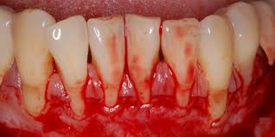

Slide 12
Diagnostic methods
After history and examination you need:
CBC and blood film morphology ….blast cells and cytopenia.
ESR……….high
LCM flowcytometry …subtypes of leukemia
Bone marrow examination…>20% blast in the bone marrow.
Gen study may be needed (ph.chromosome and bcr-abl gen in CML)
FNA from the LN may be needed .

Slide 13
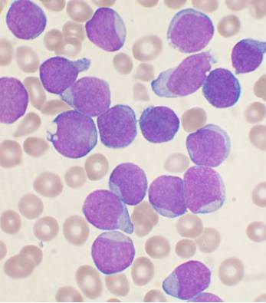
ALL…blast

Slide 14
Treatment in summery
ALL:
Needs combination treatment in phases :
1- induction phase..combination chemoth.
2- consolidation phase …combination high dose chemoth.
3- CNS prphylaxis….intrathecal or radiotherapy .
4- maintenance therapy oral therapy and intrathecal therapy .
5- May consider bone marrow transplantaion for high risk relapse.

Slide 15
AML
Combination chemoth.then either follow up or bone marrow transplantaion for high risk pt.

Slide 16
CLL:
Observation is the main part of managing CLL and treatment (chemotherapy)given only if indications present :
1-Falling hemoglobin or platelet count
2-Progression to a later stage of disease
3-Painful, disease-related overgrowth of lymph nodes or spleen
4-An increase in the rate of lymphocyte production

Slide 17
CML
:
Since the bcr-abl gen mutation present in about 95% the imatinib (gleevec )is the main part of treatment.
Gleevec is atyrosine kinase inhibitor that inhibit the active tyrosine kinase involved in the pathogenesis of CML .
it has relatively few side effects and can be taken orally at home. With this drug, more than 90% of people will be able to keep the disease in check for at least five years,[54] so that CML becomes a chronic, manageable condition.

Slide 18
Summery
4 main types of leukemias (ALL,AML,CLL.CML)
The abnormal growth of white blood cells will crowed the other bone marrow components to result in the bone marrow failure .
Both inherited and environmental factors are involved in the pathogenesis.
Bleeding and infection and anemia are the main symptoms.

Slide 19
Acute leukemias needs urgent treatment , while in chronic leukemia we can wait and treatment only if indicated .
Observation can be an option in CLL .
Bcr- abl gen is an important target in CML .

Slide 20
THANKS

